Slide 1
SENTIMENT ANALYSIS
AN ARTIFICIAL INTELLIGENCE PROJECT
NAAN MUDHALAVAN PHASE - 3

Slide 2
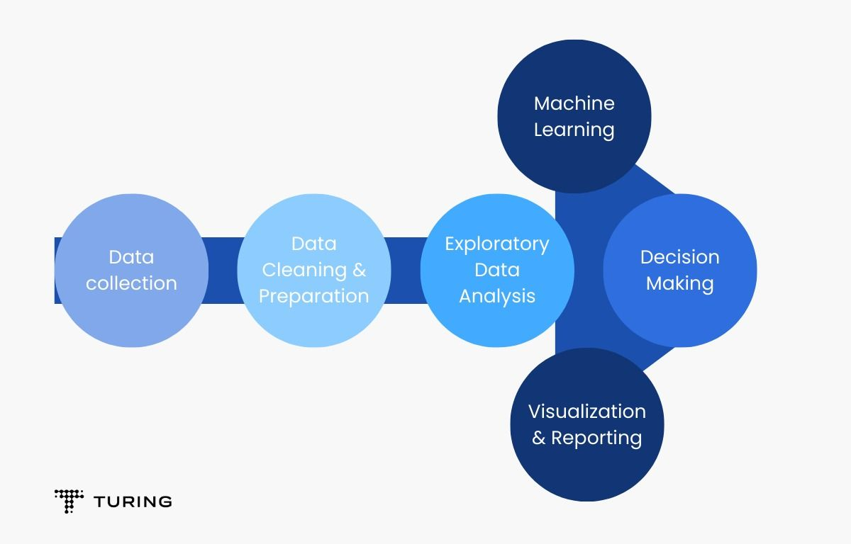
PREVIEW
PROJECT TITLE: Sentiment analysis using twitter airlines dataset
PROCESS AND OPERATION: Data collection and data preprocessing
TO PERFORM THIS OPERATIONS IN THE TWITTER AIRLINE DATASETS, WE NEED TO COLLECT THE TWEETS USING TWEEPY AN PYTHON LIBRARY AND PERFORM PREPROCESSING TO DERIVE DESIRED MODEL.

Slide 3
DATA COLLECTIONS
Collecting Twitter data, especially historical tweets, can be a complex process, and it's important to adhere to Twitter's policies and terms of service. To collect Twitter airline-related data using the Twitter API and perform basic data preprocessing. Note that you will need to set up a Twitter Developer account, create a Twitter App, and obtain API keys to access Twitter data.
STEP 1:Data Collection using Tweepy (Python Library):
Install Tweepy:
Install the Tweepy library, which allows you to interact with the Twitter..
use the code -> pip install tweepy
STEP 2:Access Twitter API:
Use your Twitter Developer account to create an App and obtain the API keys (API Key, API Secret Key, Access Token, Access Token Secret).
STEP 3: Collect data from twitter airlines dataset using python scripts

Slide 4
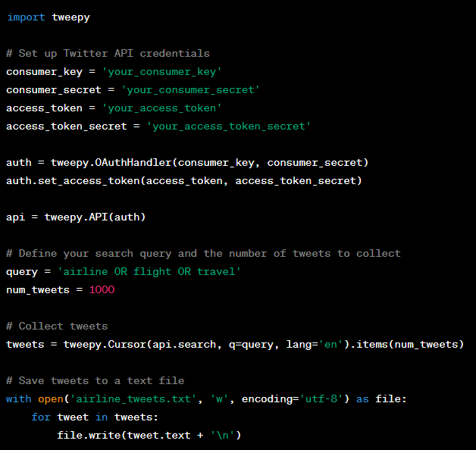
PYTHON SCRIPT – DATA COLLECTION
Python Script to Collect Tweets:
Create a Python script to collect tweets based on a specific query or keyword.

Slide 5
DATA COLLECTIONS LIMITATIONS:
Note that Twitter's API has limitations on the number of tweets you can collect, and you may need to implement pagination and rate limiting in your script.
Data collection limitations when collecting data from social media platforms like Twitter, or any web source, are important to consider. These limitations can impact the quantity and quality of the data you collect and should be taken into account when designing data collection strategies. Here are some common limitations to be aware of:
API Rate Limits: Most social media platforms, including Twitter, impose rate limits on their APIs. These limits control how many requests you can make within a specified time frame. Exceeding these limits can result in temporary or permanent suspension of API access.
Data Volume: The amount of data available may be limited. For example, you may not be able to access historical tweets beyond a certain timeframe, or you may only have access to a random subset of recent tweets.
Data Bias: Social media data can be biased. Users who post on social media are not representative of the entire population, and their opinions and behaviors may not reflect the broader sentiment.
Data Sampling: Depending on your data collection method, you may be working with a sample of the total data. For example, if you use the Twitter API to collect tweets, you're getting a subset of publicly available tweets based on your query and API limitations.
Data Privacy and Permissions: Social media platforms have strict policies about data privacy and user permissions. You may be limited in the type of data you can access, and you may need to obtain explicit user consent in some cases.
Geographic Limitations: Some data may be geographically restricted due to privacy regulations or regional restrictions.

Slide 6
DATA PREPROCESSING:
After collecting the Twitter data, you'll need to preprocess it before using it for sentiment analysis. Data preprocessing typically involves the following steps:
Text Cleaning:
Remove special characters, URLs, and user mentions.
Handle hashtags, such as splitting them into words.
Convert text to lowercase.
Tokenization:
Split text into individual words or tokens.
Stopword Removal:
Eliminate common stopwords (e.g., "the," "and") that do not carry much meaning.
Lemmatization or Stemming:
Reduce words to their base form (lemmatization) or root form (stemming).
Handle Missing Data:
Check for and handle missing or empty tweets.
Remove Duplicates:
Check for and remove duplicate tweets.

Slide 7
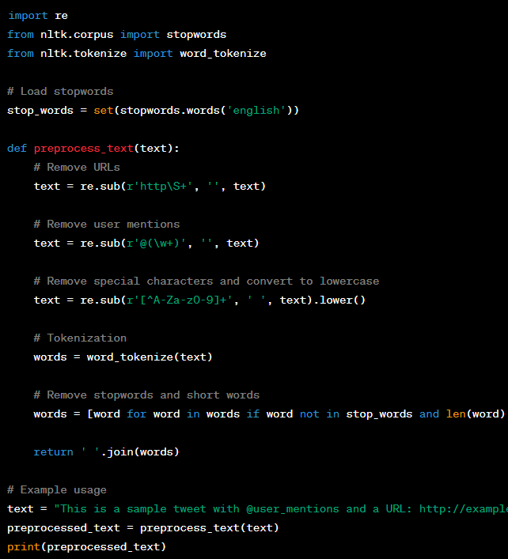
PYTHON SCRIPT – DATA PREPROCESSING
The preprocess-text function performs basic data cleaning and preprocessing on a single tweet. You can apply this function to all the tweets you've collected and then use the preprocessed data for sentiment analysis.
Certainly, data preprocessing for sentiment analysis typically involves additional steps beyond text cleaning, tokenization, stopword removal, and lemmatization. These steps aim to further prepare the data for analysis. Here are some additional data preprocessing techniques:
Removing Noise
Handling Contractions
Removing Short Words
Spell Correction
Part of Speech (POS) Tagging
Named Entity Recognition (NER)
Removing HTML Tags
Handling Emoticons and Emoji
Removing Non-English Words
Removing Duplicate Text
Handling Missing Data
Text Normalization
Feature Extraction
Sentiment Label Mapping

Slide 8
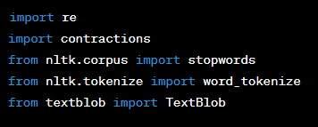
STEPS IN DATA PREPROCESSING:
Import all the necessary libraries to the code editor.
1. “re”
2.”contractions”
3.” stopwords from nltk.corpus ”
4.”word_tokenize from nlkt.tokenize”
5.”TextBlob from textblob”

Slide 9
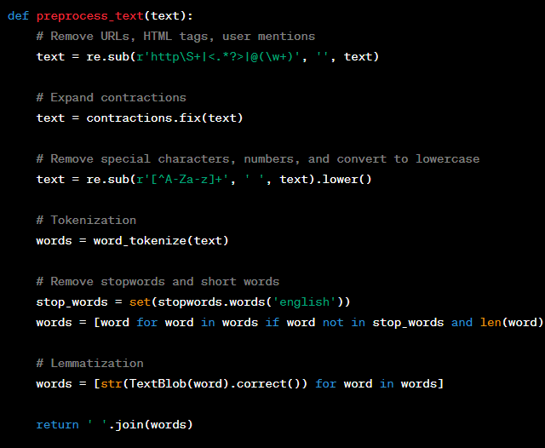
TECHNIQUES IN DATA PREPROCESSING:
Then after importing all such libs then just perform the various operations in the data preprocessing. Write a function named “ preprocess_text
In this script we have done some data preprocessing techniques
Like,
Text contractions
Remove URL, html tags, mentions, special Characters, numbers and convert to lower case.
Tokenization
Removed stopwords and short forms
Lemmatization
Then we return all of the preprocessed dateset to join together and the we use it in the realtime tweet.

Slide 10

Performing data preprocessing with a tweet
Now , the ‘preprocess_text’ function combines various preprocessing steps to clean and prepare text data for sentiment analysis. You can apply this function to your entire dataset to preprocess the tweets or text data before running sentiment analysis.
Data preprocessing can be highly tailored to the nature of your data and the requirements of this sentiment analysis project using twitter airline dataset.
Thes are the steps involved in data preprocessing and these preprocessed text can be used for actual data modelling to analyse the sentiment in the tweets in twitter airline dataset.

Slide 11
THANKING YOU

